Slide 1

From Data to Wisdom: Credit Risk Assessment using the DIKW Framework
Presented By: Arnav Singh Bhardwaj

Slide 2
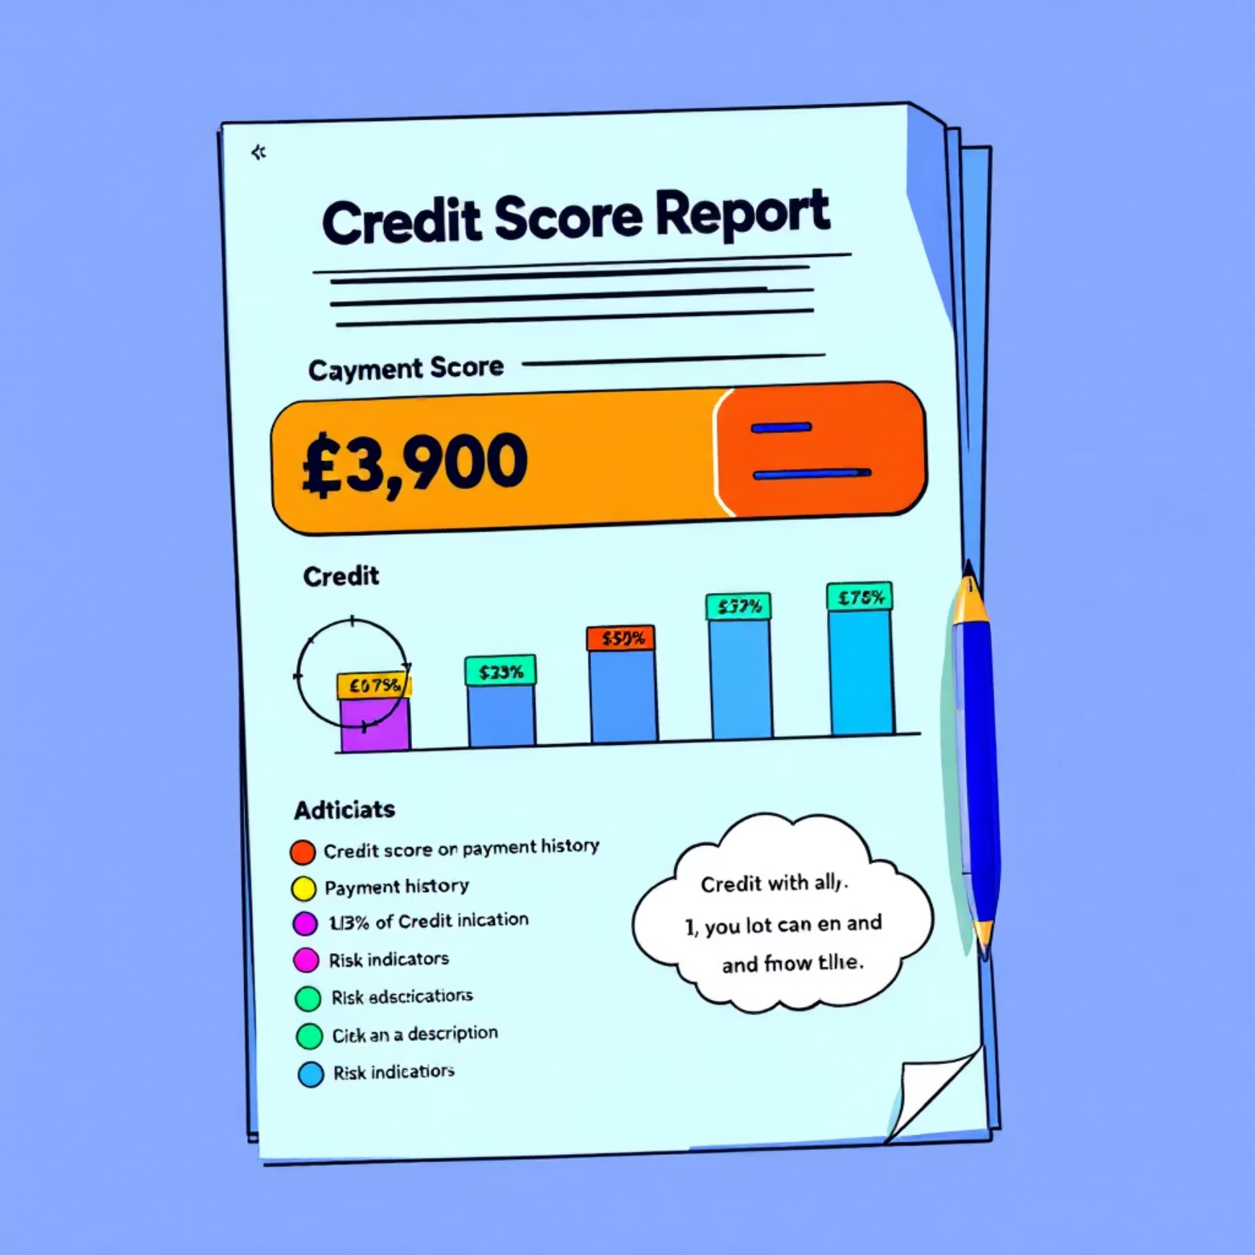
Objective & Dataset
Goal
Key Variables
Predict likelihood of loan default and provide business-ready recommendations for optimized credit policy decisions
Age, Monthly Income, Credit Utilization, Debt Ratio
Dataset
Target: SeriousDlqin2yrs (default: 1 = yes, 0 = no)
"Give Me Some Credit" (Kaggle – 150,000 records)

Slide 3



Phase 1 – Data Cleaning
Invalid Data Removal
Missing Value Treatment
Outlier Management
Removed invalid ages (≤ 0) and duplicate records
Filled missing values using median/mode appropriate to distribution
Capped outliers (e.g., DebtRatio, Income) to prevent model skew
Final dataset: 149,229 clean records × 11 features

Slide 4
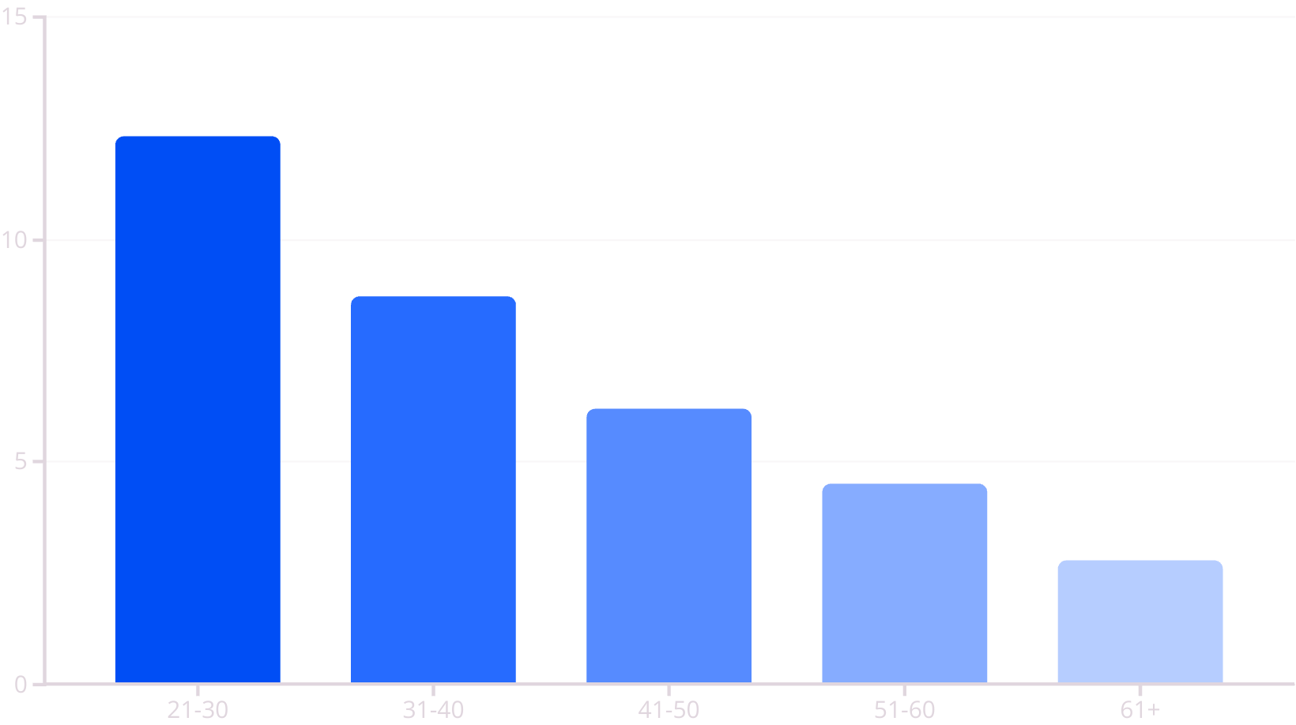
Phase 2 – Descriptive Analysis
Default Rate: 6.7%
Younger borrowers had significantly higher default risk
High credit utilization & debt ratio strongly linked to default
Most customers had 0–2 dependents and <10 open credit lines
Late payments history showed strong correlation with future defaults
Analysis included histograms, boxplots, and group-wise default rates to identify key patterns

Slide 5
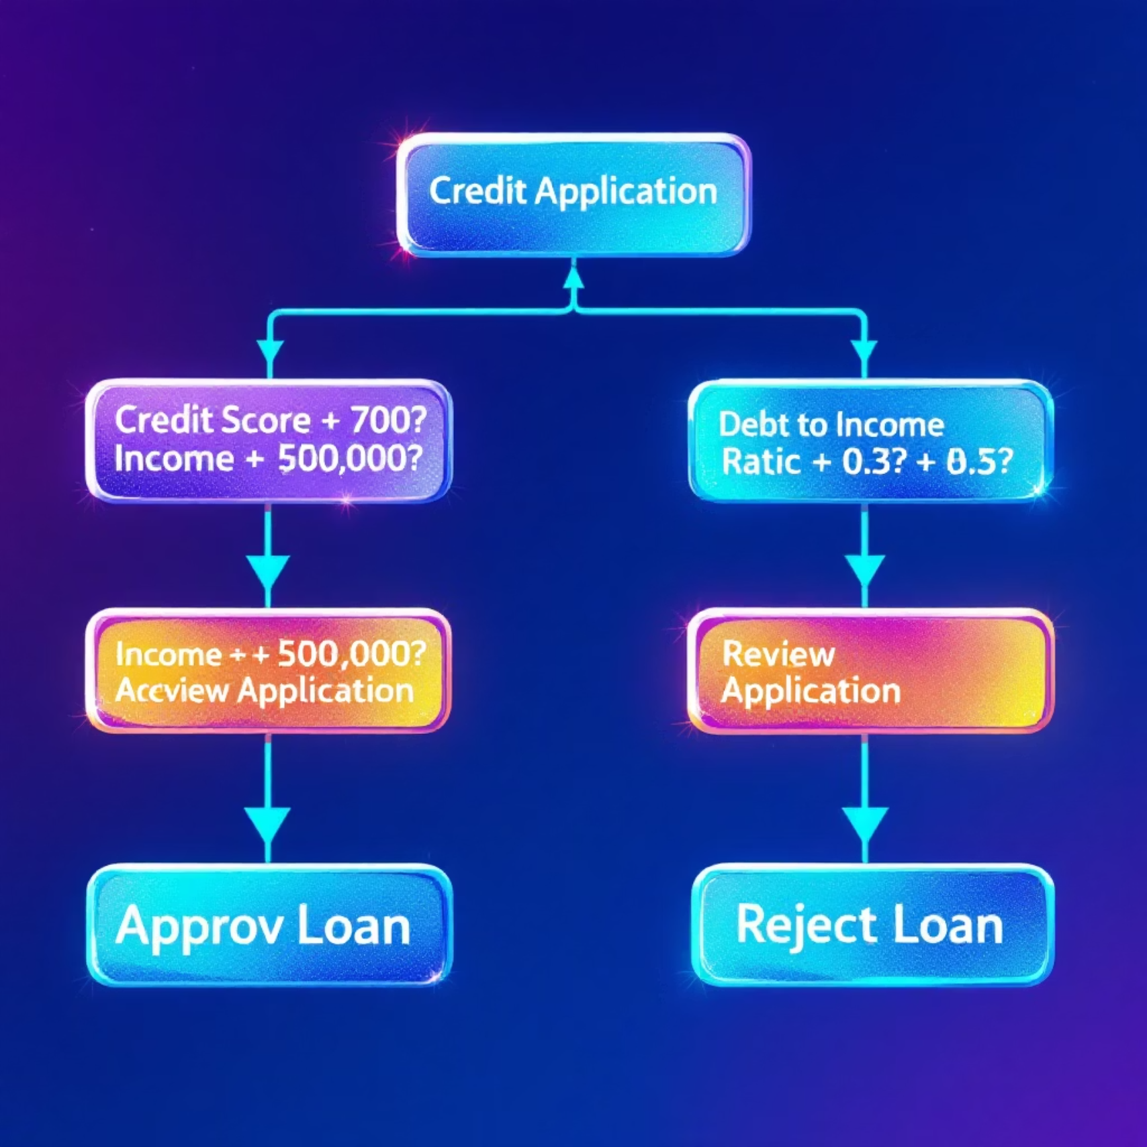
Phase 3 – Knowledge Extraction
Logistic Regression Insights
Credit Utilization ↑ → Default Risk ↑ (Coefficient: 0.87)
Late Payments (30–90 days) = Strongest Risk Signals (Coefficient: 1.24)
Age & Income ↓ → Higher Risk (Coefficients: -0.62, -0.75)
Decision Tree: Clear splits show interpretable rules for default prediction, with 76% accuracy on test data

Slide 6

Phase 4 – Strategic Recommendation
Segmented Credit Policy
1
2
3
Low Risk Segment
Medium Risk Segment
High Risk Segment
Pre-approve, offer personalized deals with higher credit limits
Monitor & reassess after 6 months with conditional approvals
Deny or flag for manual review with additional documentation
Default probability < 3.2%
Default probability 3.2% - 8.5%
Default probability > 8.5%
Data-driven thresholds ensure smart, balanced lending with 22% potential reduction in default rates

Slide 7
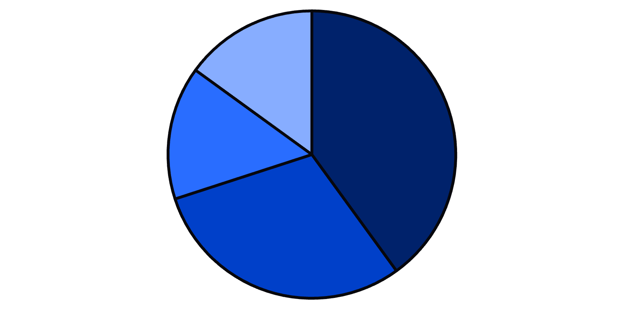
Phase 5 – MCDA: Policy Evaluation
Three Policy Options Evaluated
A: Conservative
Strict approval criteria
Score: 5.9/10
B: Balanced ✅
Smart risk-reward balance
Score: 6.7/10
Risk Reduction
Growth
Simplicity
Revenue
C: Aggressive
Balanced approach provides optimal trade-off between scale and safety
Growth-focused approach
Score: 4.3/10

Slide 8




Final Impact
Risk Reduction
Improved Targeting
Complete DSS
Reduce default exposure by 22% via data-led decisions and proactive risk management
Enable precise segmentation for personalized credit offers that maximize approval rates
Provides a comprehensive Decision Support System with clear recommendations and implementation guidance

Slide 9

Credits & Tools
Project Team
Tools Utilized
Avinash & Arnav: Data Cleaning & EDA
Rishav: & Shailaja: Model Development
Prajwala & Rishav: Feature Engineering
Shailaja & Avinash: MCDA Analysis
Arnav & Prajwala: Visualization & Reporting
Final project for Decision Support Systems – DIKW Framework
Python & Pandas for data processing
Matplotlib & Seaborn for visualization
Scikit-learn for model development
Gamma.app for presentation

Slide 10

Thank You
Questions & Discussion

